Slide 1
Wireless Hacking Attacks Using ARP Poisoning & DNS Spoofing
Project Team 5: Shivam Amin, Ravi Gadgil, Vincent Nguyen, Brian Pham, and William Tran
CS 166-Section 01: Information Security
Dr. Chao-Li Tarng Class Time: 3:00 PM - 4:15 PM; Presentation Time: 3:12 PM - 3:24 PM

Slide 2
Overview
Though wireless networks have been rapidly catching up to wired networks in recent years, the former has a glaring issue: questionable security.
The signal passed through a wireless networks isn’t restricted to a wire!
There’s valuable information being transferred between entities in a wireless network…
A malicious hacker would perhaps want to gain unauthorized access to that network or intercept the network traffic.
Hence, it’s important to identify the vulnerabilities in our networks and perhaps even find solutions to eliminate them!

Slide 3
Objectives & Scope
Conduct two types of attacks: ARP poisoning and DNS spoofing
Attack 1: ARP poisoning is a MiTM attack that allows you to intercept network traffic.
Attack 2: DNS spoofing can be used to redirect victims to certain IP addresses.
The goal of these two attacks is to collect password information…
These passwords will then be stored in a file!
A side goal would be to also analyze the traffic going on when the attack occurs, through the use of Wireshark
See how far the attack can go!

Slide 4
Architecture
Tools Used for Project
Ettercap: Software suite of man-in-the-middle attack methods. Has tools to conduct ARP Poisoning and DNS Spoofing.
Kali Linux: “Sandbox” or safe environment for safely running wireless hacking experiments and attacks.
VirtualBox: Virtualization software that allows us to run the Kali Linux server Operating System (OS).
Apache 2 Server: Open-source software for maintaining and hosting website assets and content.
Wireshark: Capture the ARP Poisoning attack details to make sure that the attack is working

Slide 5
Project Design and Algorithm: Apache 2 Server Setup
Download Apache 2 Server tool.
Edit index.html to include code that creates a fake Yahoo login page when executed. Create error.html to be the fake “Error” page user is redirected to after entering their credentials.
Create a PHP script that will read the Password and Username from the index.html file and store it to a file.
This PHP file will also redirect the user to the error.html page. Start our Apache 2 Server to maintain and host these HTML pages as website content that is accessible via the Apache 2 Server IP address.

Slide 6
Project Design and Algorithm: Ettercap Setup
Edit the etter.dns file in Ettercap to change the official domain name “yahoo.com” to our Apache 2 Server IP address. This ensures that the user will be redirected to the fraudulent login page on our Apache 2 server when they try to access the official Yahoo website.
Open the Ettercap GUI.
Add the router as Target 1 and the victim as Target 2.

Slide 7
Project Design and Algorithm: Conduct the Attacks
Do Attack #1 by starting a man-in-the-middle attack using the ARP Poisoning tool that intercepts traffic between the router and the victim.
Do Attack #2 by enabling the DNS spoofing plugin which will redirect the user to our fake login page when they try to access “yahoo.com”.
User will enter their information into the fraudulent login page and get redirected to our “Error” page which will make them less suspicious of an attack.
Access file on Kali Linux containing the user’s login credentials.

Slide 8

Video Demonstration

Slide 9
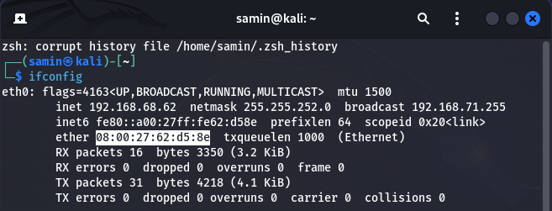
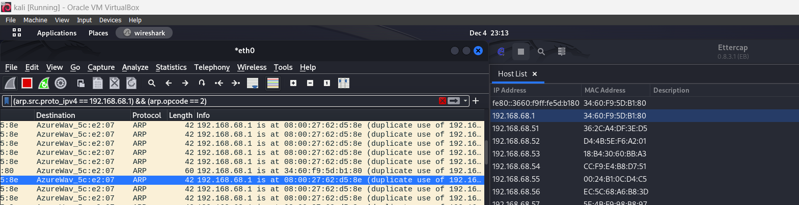
Results & Analysis of ARP Poisoning Attack
ARP (Address Resolution Protocol)
What is supposed to happen:
Device trying to connect to the default router asks the network who is XXX.XXX.XXX.XXX (example of ip address of router) and the router with the matching ip responds with its MAC address
Results of what is happening after our attack:
Device is getting back the wrong MAC address because of the attack, instead of getting back the MAC address for the router, it is being provided the address of the Kali Linux server.
Now what happens is the packets get sent to the Kali Linux Server which we can now sniff before sending it back to the original router so that the targeted device is not made suspicious of the attack.

Slide 10
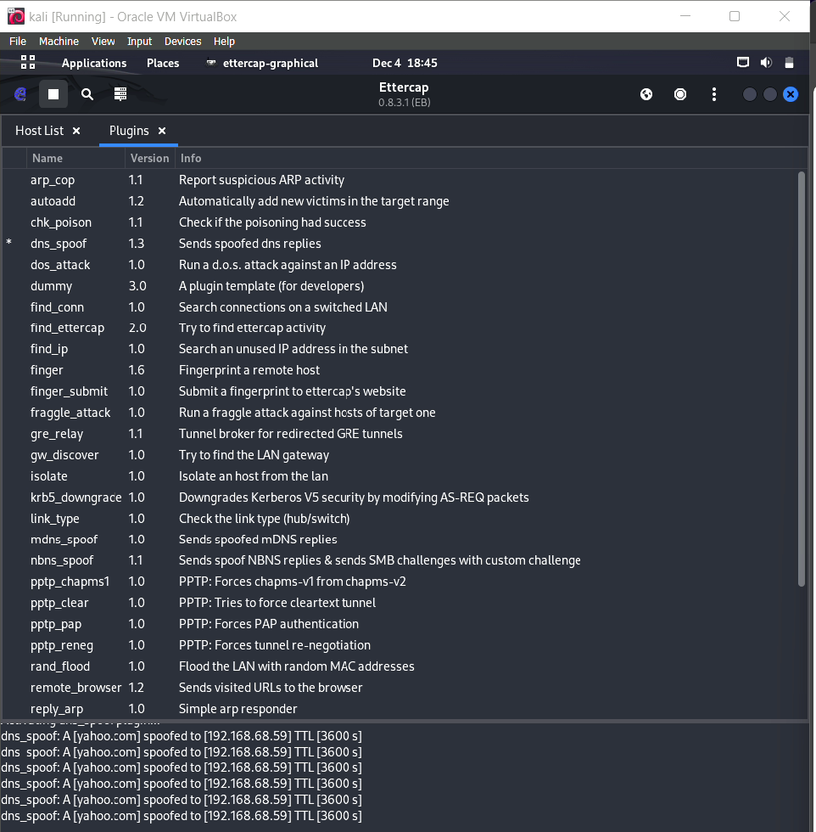
Results and Analysis of DNS Spoofing Attack
Redirected yahoo.com search to 192.168.68.59
That is the IP of the Apache2 server
Spoofing works without the user finding out about it

Slide 11
Future Work Suggestions
HTTPS is too secure
ARP poisoning should be enough to get logins but HTTPS that uses HSTS prevents this
Can try SSLStripping to connect a user to HTTP version of website
Fake website might look different from authentic website
create a fully working login page in the HTML file
can try a script that scrapes the login page and copies the HTML code
Can potentially be used to track a user
Use a phone
smaller device is more incognito to use

Slide 12
Conclusion
Wireless hacking using DNS Spoofing overall successful
Resolved issues along our progress
Demonstrated potential vulnerabilities from simple spoofing
Demonstrated ease of ARP poisoning
Operations can be improved for future works
Using different software/methods mentioned earlier

Slide 13
References
Ettercap: https://www.ettercap-project.org/
Kali Linux: https://www.kali.org/docs/
Apache 2 Server: https://httpd.apache.org/
SSLStripping: https://www.keyfactor.com/blog/what-are-ssl-stripping-attacks/
ARP Poisoning: https://www.imperva.com/learn/application-security/arp-spoofing/
DNS Spoofing: https://www.imperva.com/learn/application-security/dns-spoofing/#:~:text=App%20SecurityThreats-,What%20is%20Domain%20Name%20System%20(DNS)%20Spoofing%3F,resemble%20the%20user's%20intended%20destination.

